Slide 1

LinkedIn Job Postings Analysis(2023-2024)
(Project2)
Name: Fatima Jawad Isa

Slide 2

The Problem Statement
Between 2023-2024, the 124k job advertisements were posted on LinkedIn in the United States; 69% required an intermediate level of experience, while only 31% were suitable for recent graduates . this disparity results in job seekers spending time applying for positions for which they do not qualify.

Slide 3
TABLE OF QUESTIONS
01
02
03
04
05
06
what are the most in demand jobs in the market
which jobs accept beginners
which city should i choose based on my specialization
Which companies hire the largest number of entry-level employees
on which day of the week are the highest number of jobs posted
How many days does the job posting remain active before it expires
07
What is the expected salary for each experience level (entry-level, mid-level, manager..)

Slide 4
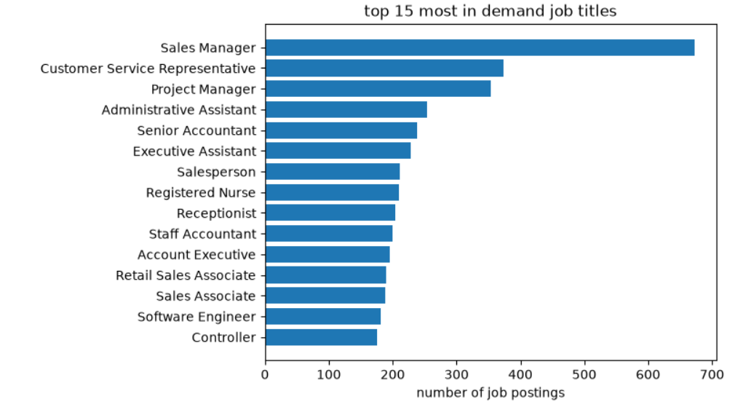
Q1: what are the most in demand jobs in the market:
( it gives job seekers a clear visual map of the most in demand positions )

Slide 5
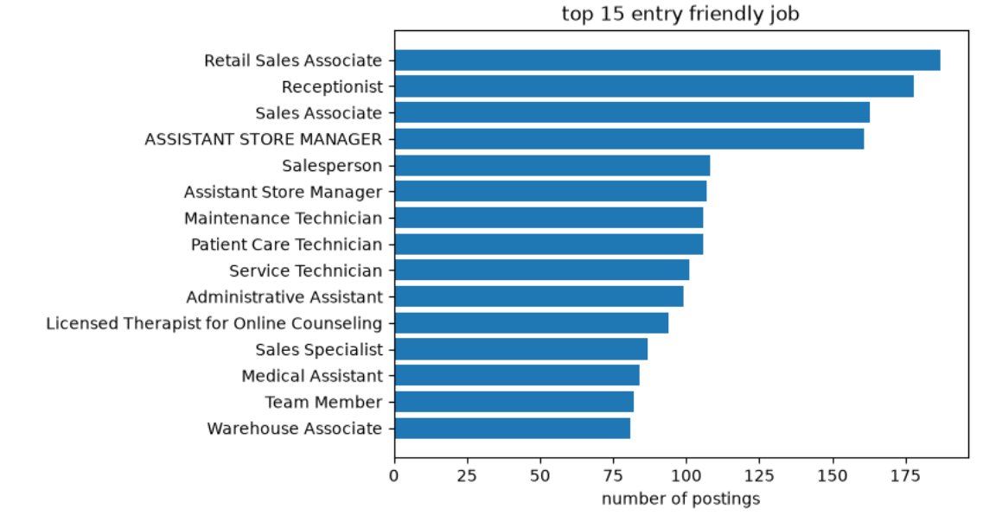
Q2: which jobs accept beginners:
( it saves time and effort for new graduates and increases their chances of acceptance )

Slide 6
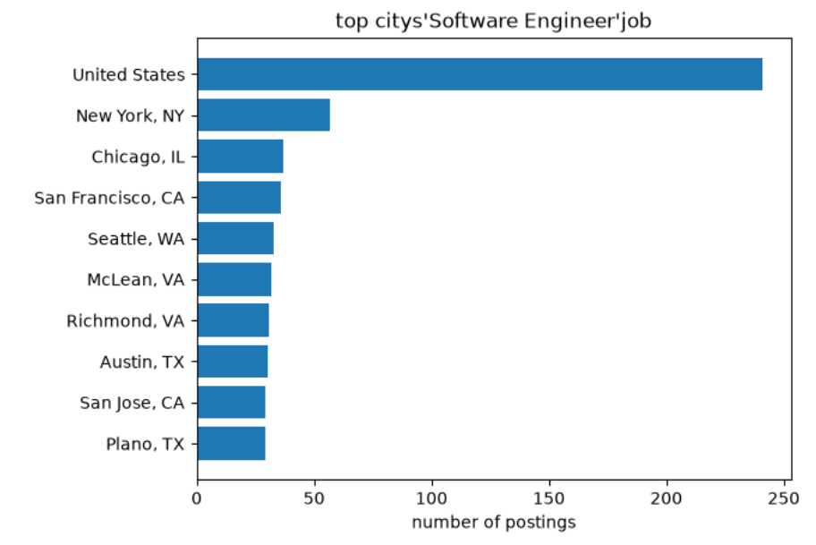
Q3: which city should choose based on my specialization:
( for anyone willing to relocate by pinpointing which city has the highest demand for their specialization )

Slide 7
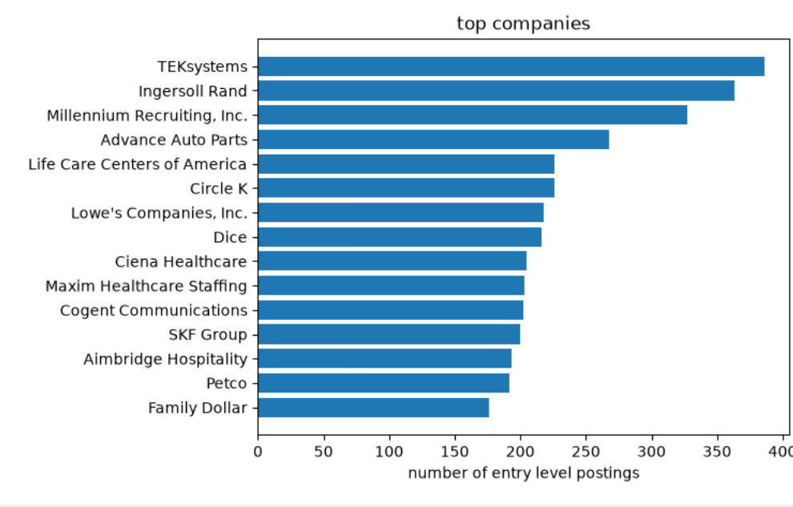
Q4: Which companies hire the largest number of entry-level employees:
( Ther recent graduate is provided with a specific list of companies to target for research )

Slide 8
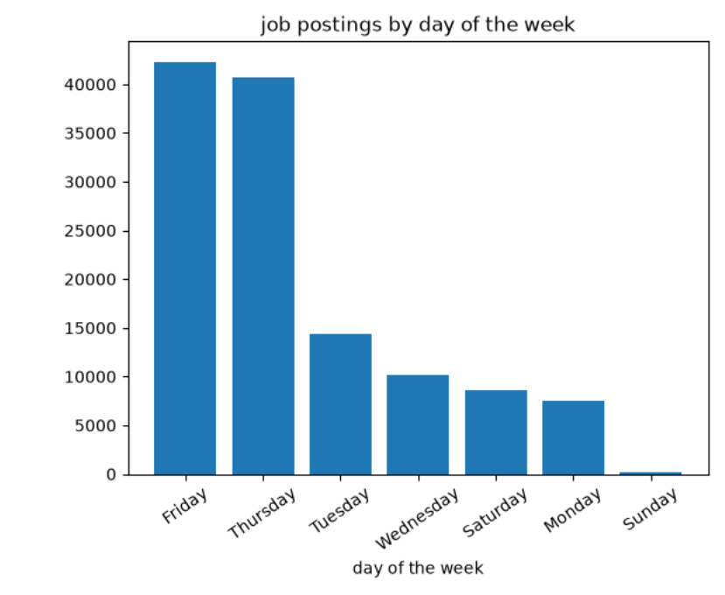
Q5: on which day of the week are the highest number of jobs posted:
( for job seekers to know the best time to follow up on the latest opportunities )

Slide 9
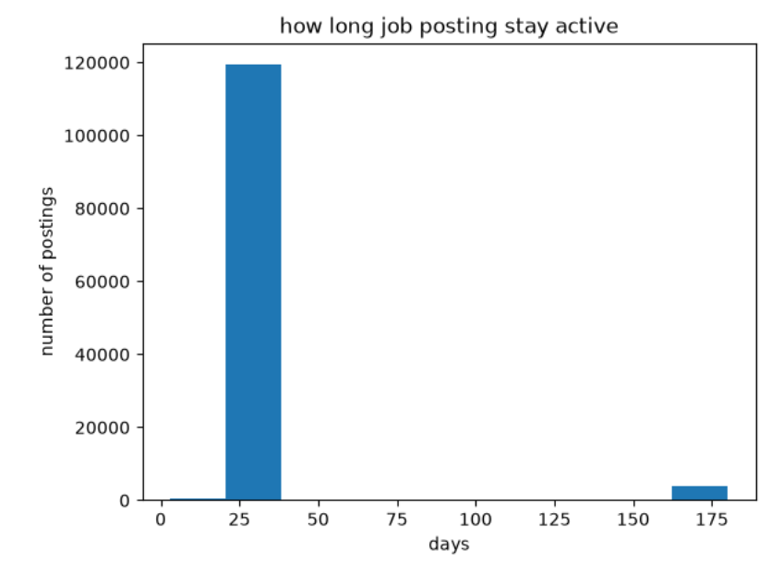
Q6:How many days does the job posting remain active before it expires
( It gives the job seeker an idea of ​​the time available to apply before the advertisement expires )

Slide 10
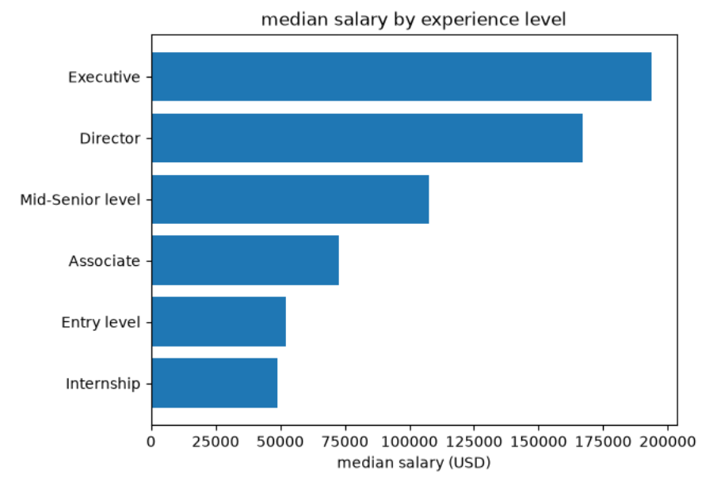
Q7: What is the expected salary for each experience level (entry-level, mid-level, manager, executive...):
( A job seeker provides a realistic salary range—based on their level of experience )

Slide 11
Recommendation
1.Target beginner-friendly jobs : Titles like Retail Sales Associate, Receptionist, have many entry-level openings.
2.Apply early: Most job postings stay active for only 30 days.
3.Check LinkedIn on Thursday and Friday: About 67% of jobs are posted on these two days.

Slide 12
Next Step:
Analyze job descriptions: Extract required skills from the descripting text to show beginners what to learn for each title.

Slide 13

THANKS!

